Slide 1




NEXT GEN EMPLOYABILITY PROGRAM
Creating a future-ready workforce
Team Members
College Name
Student Name : PRIYADHARSHINI. A
Student ID:620321104078
Bharathiyar Institute of Engineering for Women,Salem.

Slide 2

CAPSTONE PROJECT SHOWCASE
Project Title
Building Bus Reservation System using Python and Django
Abstract | Problem Statement | Project Overview | Proposed Solution | Technology Used | Modelling & Results | Conclusion

Slide 3
Abstract
The proposed system incorporates advanced features such as real-time booking capabilities, dynamic pricing algorithms, and user-friendly interfaces accessible via web and mobile platforms. Integration with GPS technology enables precise tracking of buses, allowing passengers to monitor arrival times and plan their journeys effectively.
Furthermore, emphasis is placed on accessibility and inclusivity, with provisions for special needs passengers and multilingual support. Security measures are implemented to safeguard passenger information and transactions, ensuring confidentiality and trust.
Overall, the optimized bus reservation system outlined in this abstract represents a significant advancement in transportation technology, offering a seamless, efficient, and user-centric solution for modern travelers.
Source :

Slide 4
Problem Statement
Limited Scalability: Many existing bus reservation systems struggle to accommodate increasing demand and route expansions efficiently.
Inefficient Booking Processes: Cumbersome booking procedures, outdated interfaces, and lack of real-time updates contribute to a poor user experience.
Inaccurate Demand Forecasting: Limited capabilities in demand forecasting result in inefficient route planning and scheduling.
Accessibility and Inclusivity: Accessibility barriers persist for passengers with special needs, including those with mobility impairments or language barriers.
Data Security and Privacy Concerns: With the increasing digitization of reservation systems, ensuring the security and privacy of passenger data becomes paramount
Source :

Slide 5
Project Overview
Frontend:
User-friendly interface for booking tickets, viewing schedules, and tracking buses.
Backend:
Database management, algorithms for route optimization, payment processing, and data analytics.
Integration:
GPS tracking for real-time location updates, integration with payment gateways, and accessibility features.
Seat Booking and Availability:
Users can check seat availability for specific routes and dates . The system provides an intuitive interface for selecting seats and making reservations.
Source :

Slide 6
Proposed Solution
1.User-Centric Interface:
Develop a user-friendly interface accessible via web and mobile platforms.
2. Dynamic Pricing Mechanism:
Introduce dynamic pricing algorithms based on factors such as demand, time of booking, and seat availability.
3. Advanced Analytics and Forecasting:
Utilize data analytics and machine learning algorithms to forecast demand, optimize route planning, and allocate resources efficiently.
4. Accessibility Features:
Ensure accessibility for passengers with special needs by providing wheelchair-accessible vehicles, priority seating options, and multilingual support.
Source :

Slide 7
5.Authentication and Authorization:
Implement user authentication mechanisms to secure user accounts and transactions.
Utilize Django's built-in authentication system to handle user registration, login, and password management.
6. Scalability and Flexibility:
Design the system to accommodate scalability and future expansion, allowing for the addition
of new routes, services, and features.
7.Seat Availability and Booking:
Integrate a seat reservation system that allows users to view available seats and
select their preferred seats for booking.
Source :

Slide 8
8.Booking Management:
Develop an admin dashboard for managing bookings, enabling administrators to view, modify, or cancel reservations as needed . Include features for updating booking details, such as seat allocations, passenger information, and payment status.
9.Payment Integration:
Consider factors such as transaction fees, supported payment methods (credit/debit cards, digital wallets, bank transfers), and compatibility with the chosen technology stack.
10.Reporting and Analytics:
Design the system with a modular architecture that separates different components such as booking, payment, routing, and analytics.
Source :

Slide 9


Technology Used
Front-end
Back-end
Source :

Slide 10
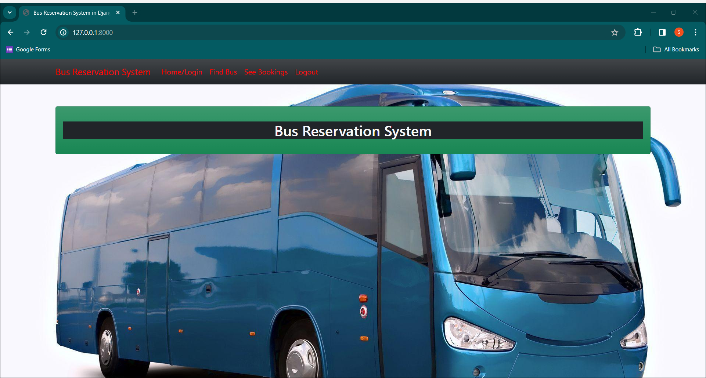
Modelling & Results
The Bus Reservation System Project can be run successfully in server the http://127.0.0.1:8000/
Source :

Slide 11
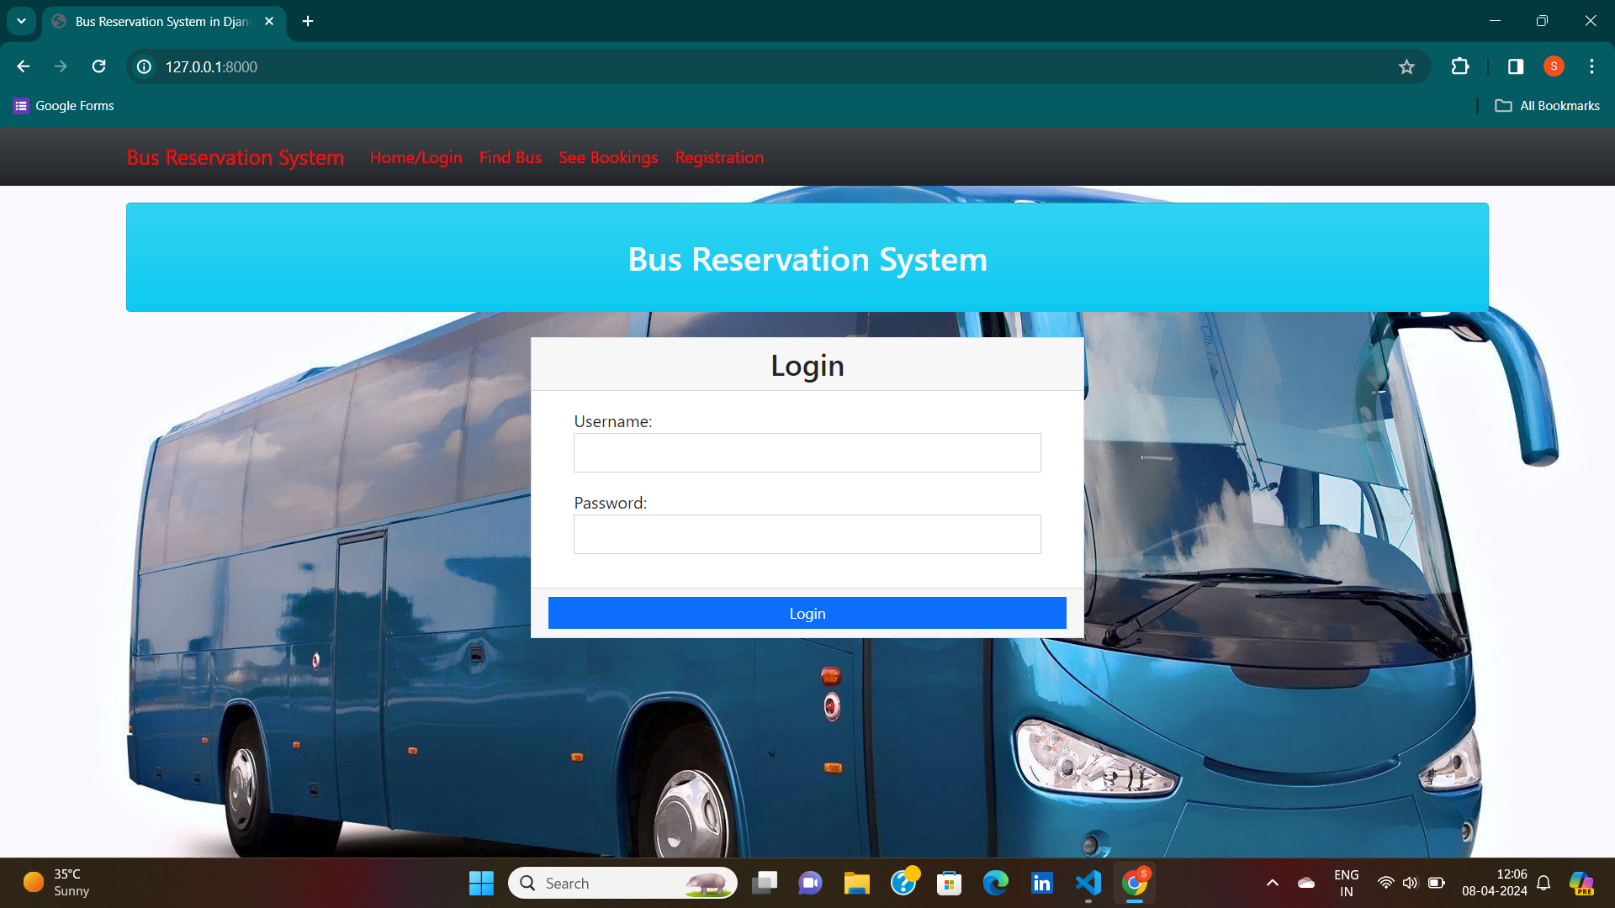
LOGIN PAGE-PAGE

Slide 12
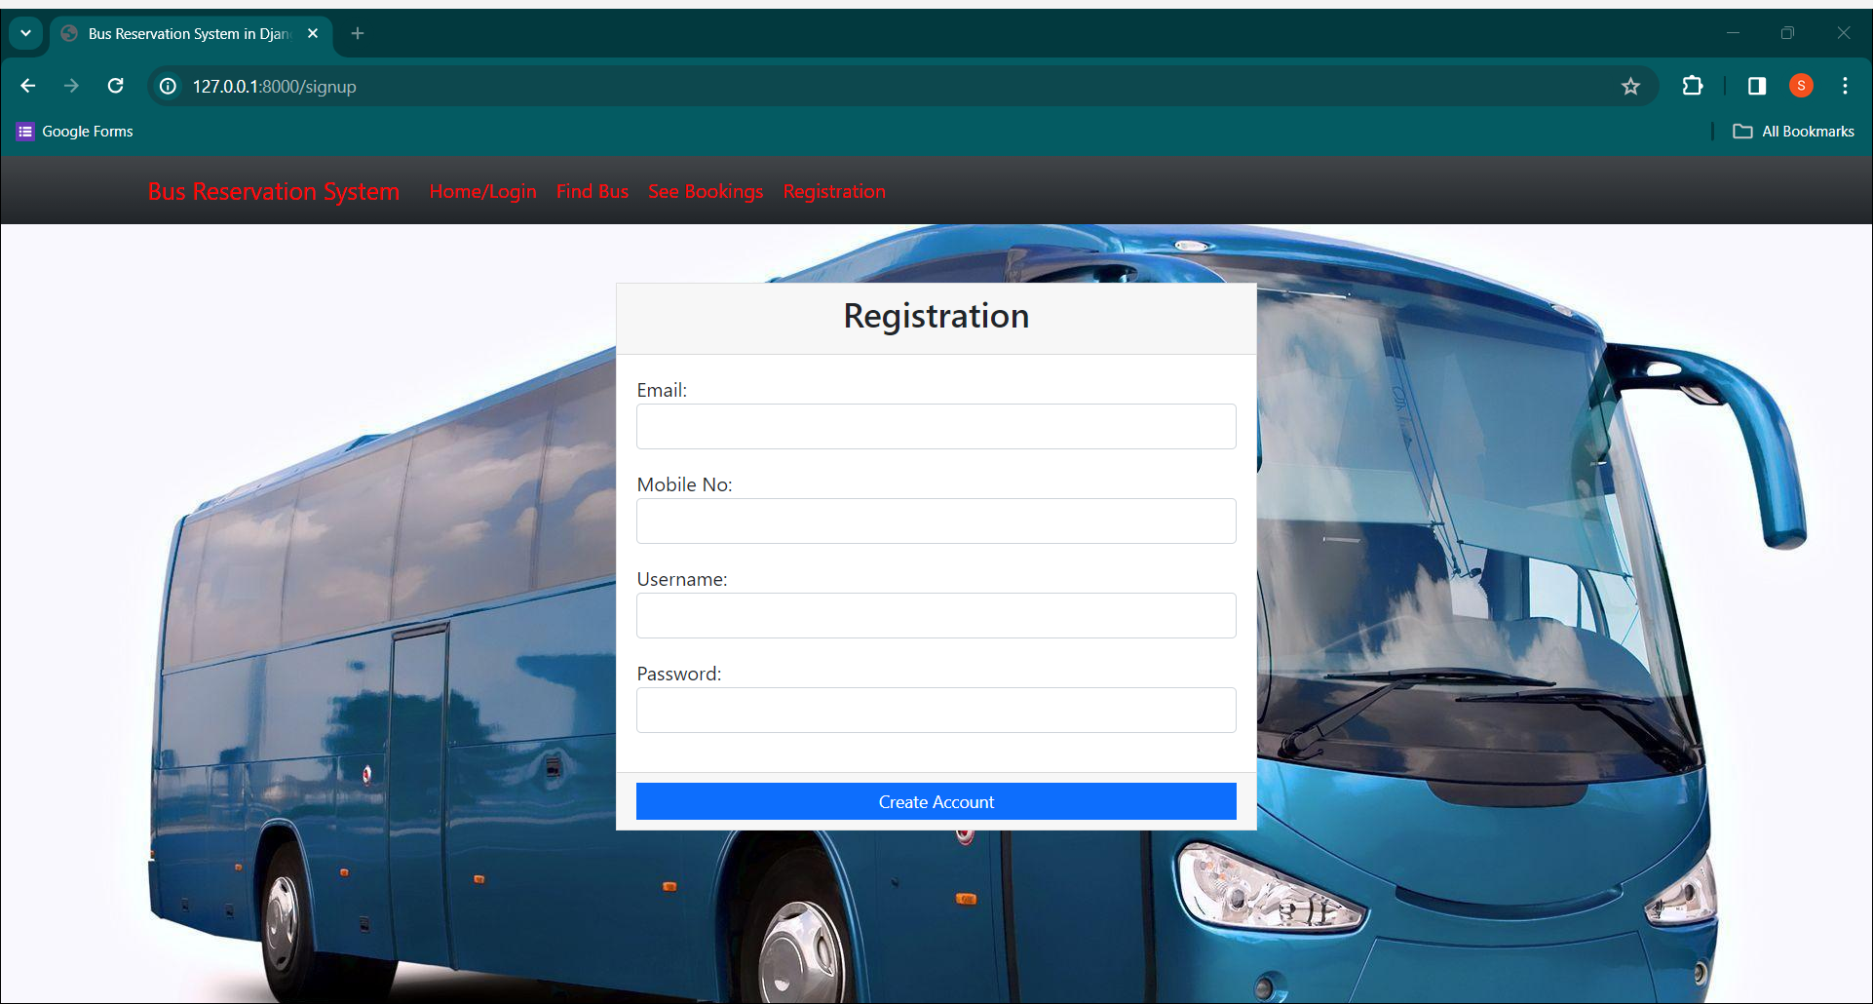
REGISTRATION-PAGE

Slide 13
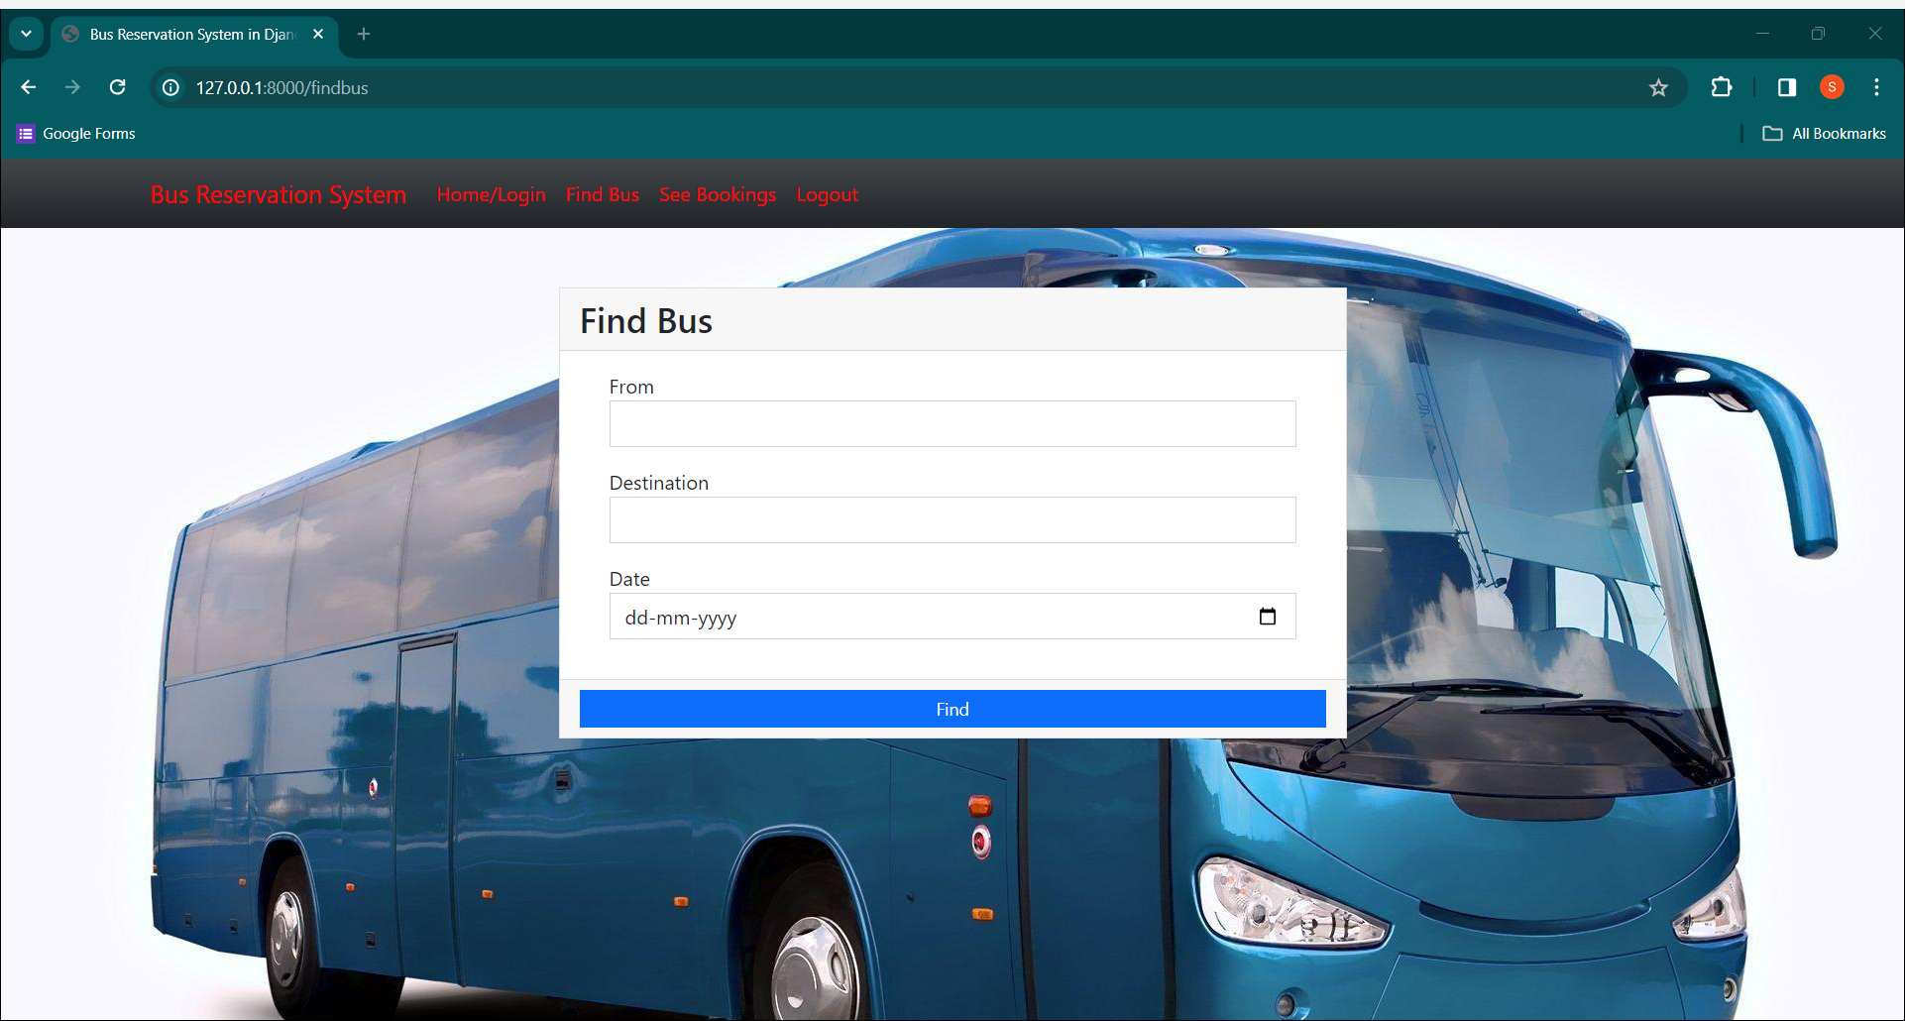
FIND BUS-PAGE

Slide 14
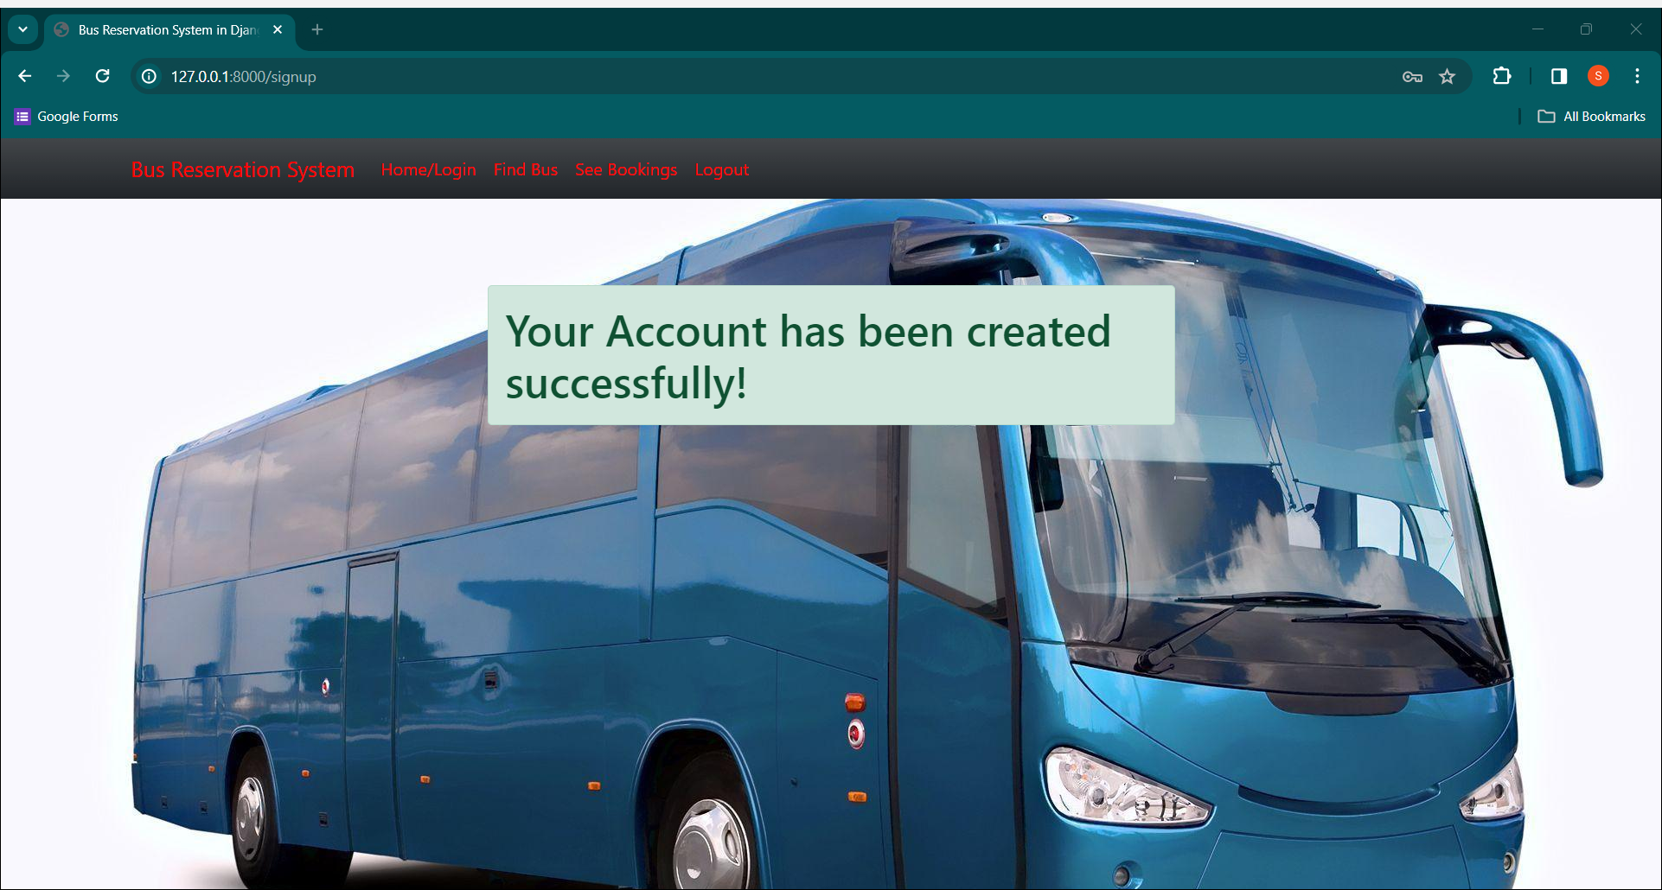
SUCCESSFULLY REGISTERED-PAGE

Slide 15
Future Enhancements:
Contactless Payments and Ticketing:
Introduce contactless payment options such as mobile wallets, NFC, or QR code scanning for ticket purchases and fare payments.
Multi-Modal Integration:
Expand the bus reservation system to integrate seamlessly with other modes of transportation, such as trains, subways, ridesharing services, and bike-sharing networks.
Sustainability Initiatives:
Implement eco-friendly initiatives such as electrification of the bus fleet, adoption of alternative fuels, and implementation of emission reduction strategies.
Blockchain for Transparency and Security:
Explore the use of blockchain technology to enhance transparency, security, and traceability in ticketing transactions and passenger data management.

Slide 16
Conclusion
The development and implementation of a bus reservation system represent a significant advancement in modern transportation management.
By leveraging technology such as real-time booking, dynamic pricing algorithms, and GPS integration, we have created a user-friendly platform that empowers passengers to plan and book
their journeys seamlessly .
The introduction of advanced analytics and forecasting capabilities enables us to optimize route planning, resource allocation, and pricing strategies, resulting in improved operational efficiency and revenue generation for bus operators.
In conclusion, the bus reservation system project represents a significant step towards revolutionizing public transportation, offering a reliable, efficient, and passenger-centric solution for modern travelers.
Source :

Slide 17
Thank You!
Notes:
Thank You !!

